Slide 1

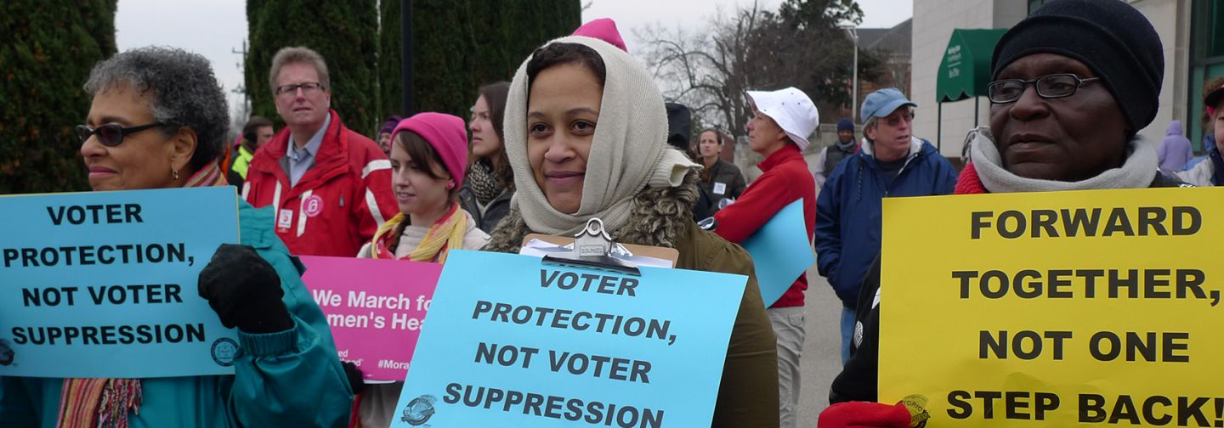
September 28, 2016
Presented by Jim Wallis, President
www.sojo.net
202-328-8842 sojourners@sojo.net
Thousands march in Raleigh, N.C. as part of the Moral Mondays Action against Voter Suppression and Special Interest groups takeover of state government. by Susan Melkisethian / Flickr.com

Slide 2
Witness the Vote
The Matthew 25 Voter Protection Project.
Putting Pastors at the Polls

Slide 3
Matthew 25
³⁵ for I was hungry and you gave me food, I was thirsty and you gave me something to drink, I was a stranger and you welcomed me,³⁶ I was naked and you gave me clothing, I was sick and you took care of me, I was in prison and you visited me.’ ³⁷ Then the righteous will answer him, ‘Lord, when was it that we saw you hungry and gave you food, or thirsty and gave you something to drink? ³⁸ And when was it that we saw you a stranger and welcomed you, or naked and gave you clothing? ³⁹ And when was it that we saw you sick or in prison and visited you?’ ⁴⁰ And the king will answer them, ‘Truly I tell you, just as you did it to one of the least of these who are members of my family, you did it to me.’

Slide 4
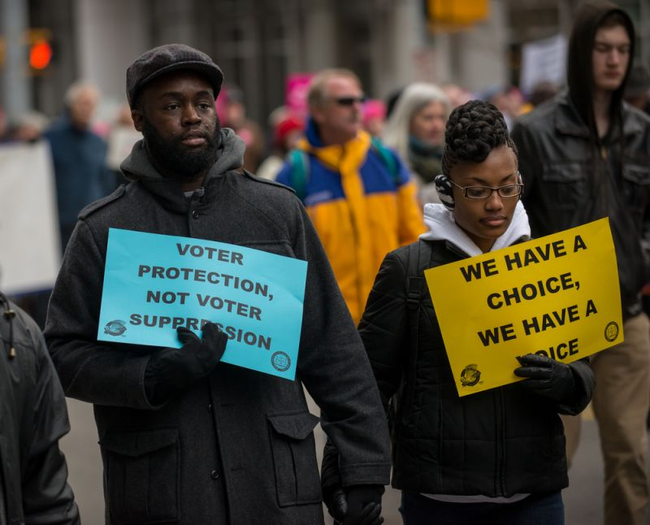
What Churches Can Do in the Election
^{CAN}
Discuss candidates’ positions on issues
Distribute voting guides (w/o bias for or against a candidate or party)
^{Host voter education events}
Use church for polling place on election day.
^{CAN NOT}
^{Endorse a candidate}
^{Support a political party}
^{Distribute campaign literature}
Donate to candidates or office holders
Moral Mondays rally, Feb. 8, 2014. EPG_EuroPhotoGraphics / Shutterstock.com

Slide 5
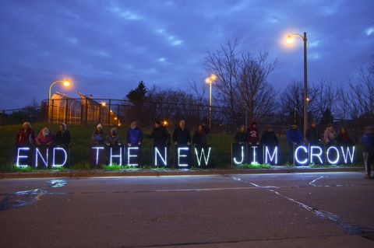
How Your Church Can Protect Voting Rights
^{1 Month Before the Election}
Host a Voter Registration Drive
Host a Voter Rights Education Meeting
^{1 Week Before the Election}
Distribute a non-partisan, issues-based voter guide
Use your church’s social media to get out the vote
^{Election Day}
Organize Car Pools to the polls
^{Help out at Polling Places}
Joe Brusky / Flickr.com

Slide 6
Witness the Vote
^{The Hungry - Bring Sandwiches}
^{The Thirsty – Bring Water}
The Poor - Organize Rides to the Polls.
The Sick and Elderly - Bring Folding Chairs
The Immigrant and Returning Citizens - Volunteer as a Trained Legal Observer

Slide 7
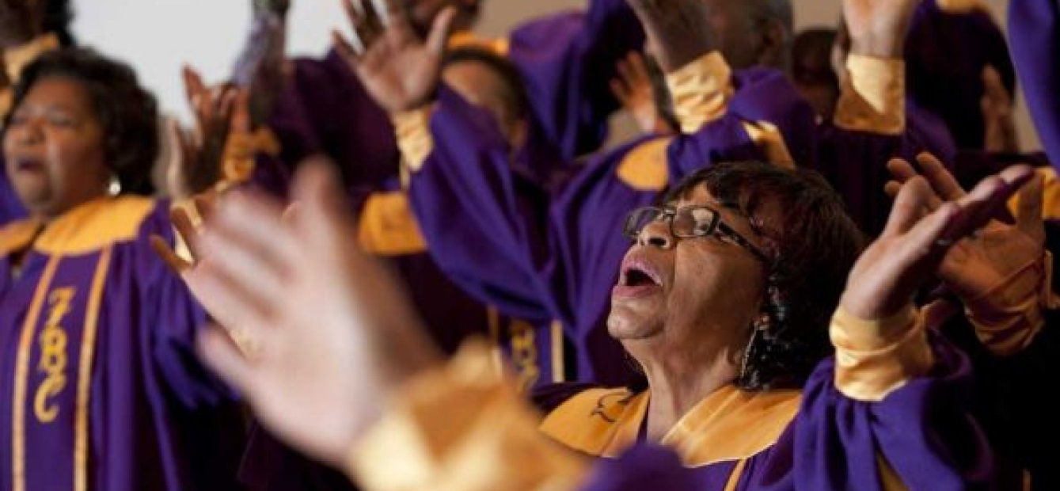
Celebrate the Vote
We are called to celebrate and protect the image of God in all Americans – to protect their divine call to help steward the world. In a democracy, the most fundamental way citizens steward the world is by exercising the right to vote
http://www.vinejuice.co.uk/church-choirs-reluctant-enter-gospel-choir-year-competitons/

Slide 8



PROTECTING THE
RIGHT TO VOTE IN 2016

Slide 9
Current landscape
Litigating Suppressive Laws
Lack of knowledge of voting laws & procedures
Competing narratives of Rigged System
Voter Intimidation
Climate Change & Election Calendar

Slide 10
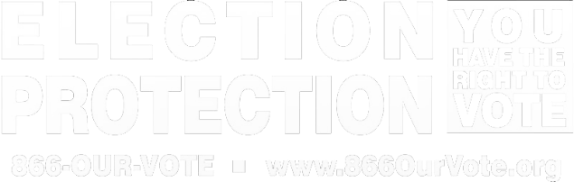
Voting Rights Litigation
Notes:
Voters have lacked basic understanding of voting process or not known when and where to vote.
We have found that election officials are unprepared for the number of voters who are turning out. This has resulted in long lines and not enough resources like poll workers, voting machines, and ballot shortages. On Super Tuesday, websites in AL, TX and CO which contained key voting information were down for part of the day.
In Texas and North Carolina, two states formerly covered by Section 5 of the Voting Rights Act, implemented voter ID laws since the Shelby decision. Voters reported being turned away for lacking voter ID, forced to cast provisional ballots, and confusion by poll workers on how to administer the voter ID laws during the primaries. Even in states without restrictive voter ID laws, there have been reports or confusion or incorrect information by poll workers for example, students at Wheaton College in Illinois were told they had to show additional forms of ID with the college’s mailing address.
Voter reg. Updating voter registration, voters not appearing on the rolls, or purging.

Slide 11




EP Overview
Hotlines
Field Programs
In 26 states (and counting)
Voter Education
Data Collection
Post-election advocacy
English: 866-OUR-VOTE
Spanish/English Bilingual: 888-VE-Y-VOTA
Asian Languages: 888-API-VOTE
Notes:
Slide Goal: Provide volunteers an overview of the EP program and partners.
Adaptation Note: Enter state specific field program info
Content:
In addition to an English line hotline, we also have partners providing assistance in other languages.
If a voter needs help in Spanish or an Asian language, call the appropriate hotline for them to try to get someone on the phone who can communicate with the voter in the language they are most comfortable in.
The Asian languages that the 888-API-VOTE hotline provides support in are: Chinese, Korean, Vietnamese, Tagalog, Hindi, Urdu, and Bengali

Slide 12
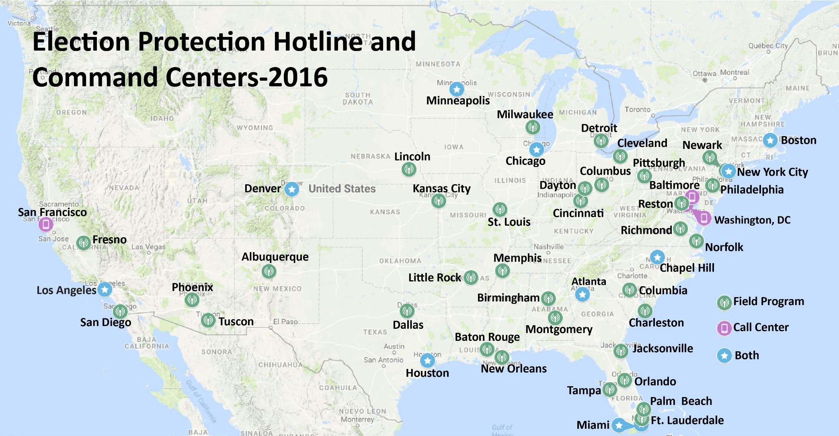
2016 Election Protection Call Centers and Field Programs
Notes:
In 2016:
12 national call centers based in DC, NY, Minneapolis and San Francisco which will take calls from multiple states
10 local call centers that will take calls from a state or metro area
We are working with partners in 26 states to build field programs where we will be monitoring problems at the polls and responding to them by contacting election officials
Since January 1, 2016 we have receive over 30,000 call to 866-OUR-VOTE

Slide 13
Election Protection By the Numbers
Since January 1, 2016: 866-OUR-VOTE has receive nearly 30,000 calls
Week of September 26, average of 400 calls per day – High call volume day was NVRD with over 900 calls
Expecting between 150,000 -200,00 during 2016 election cycle
Building field programs in 26 states
Target to recruit 3,000-5,000 volunteers

Slide 14
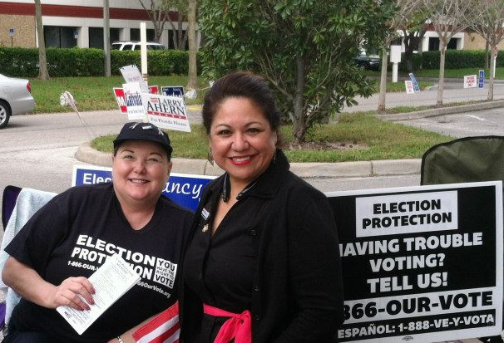
Field Program Shifts
Assignments: Volunteers are given addresses for a polling place(s) for you to monitor.
Orientation: Introduce yourself to poll workers and explain you are a non-partisan volunteer.
Work: Help voters and record interactions and call command center when needed.
Notes:
Slide Goal: Provide volunteers with the logistical info they need to be successful and hit the ground running
Adaptation Note: Add your command center’s phone number as the last line.
Trainer’s Notes:
Discuss when and from whom the volunteers should expect e-mails with their polling place assignments—or where to show up on Election Day to receive them
Explain any other logistics the volunteer needs (e.g., command center may call to tell them to go elsewhere where they’re needed, how to meet up with their partner, etc.)
Include the command center phone number on the slide and instruct volunteers to take out their phones and add that number now.

Slide 15
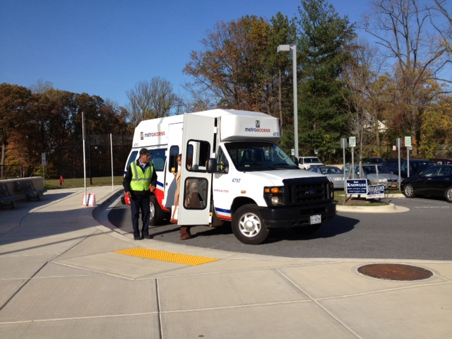
Poll Monitor Roles
Assist voters
Be EP’s eyes and ears. Identify & report problematic practices
Notes:
Slide Goal: Volunteers become familiar with their goals as a field volunteer
Content:
Volunteers will provide on-site assistance to voters by providing information and empowering them to advocate for themselves, as this slide indicates
Volunteers will identify and report problematic practices to the command center, who can intervene with election officials or instruct the volunteer on what to do on site.

Slide 16
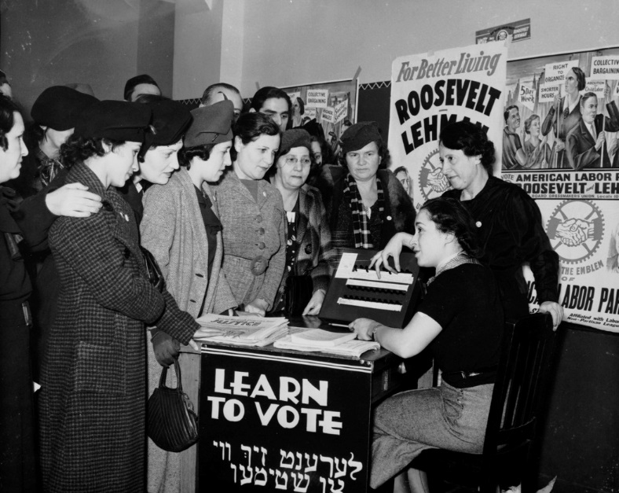
Assisting Voters
  Assist Voters by:
  Making sure voters know their rights
  Answering voting questions
  Checking voters’ registration status and polling place info
Notes:
Slide Goal: Provide overview of how field volunteers assist voters.
Trainer’s Notes:
This slide is written for volunteers who will be outside of the polling place talking to voters as they enter and exit. If your volunteers will be allowed inside the polling place, you may want to tweak this content (on the slide and how you talk about it) to better reflect the experience they are likely to have.
Content:
These are a few ways that you will be providing on-site assistance to voters.
We suggest that when a volunteer who will remain outside the polling place arrives on site they introduce themselves to a poll worker that might be walking the line or otherwise find a non-disturbing, appropriate way to say hello and let the poll worker know we’re there to help and provide non-partisan information to voters who might be at the wrong place or otherwise have questions before they go inside. It’s important not to imply that you’re there to keep an eye on the poll worker in this interaction.
Because of the work of other entities, poll workers might not love that we’re there. They might view it as looking over their shoulders. So it’s very important to be friendly and demonstrate that you’re there to be helpful to everyone, not interfere with their jobs.

Slide 17

Reporting Problems
  Report Issues by:
  Calling your command center
  Calling 866-OUR-VOTE
  For non-urgent issues, fill in a paper intake form
  Scan and e-mail to: info@866ourvote.org
Notes:
Slide Goal: Provide overview of how field volunteers assist voters.
Adaptation Note: Edit to reflect the reporting structure your field program has decided upon—prioritize who your volunteers are calling in what order—or provide instructions as to what they call in to whom. Add the right phone numbers, e-mail address, etc. that your volunteers should use (text in red).
Trainer’s Notes:
Talk about the types of issues that volunteers will call in (e.g., lines, improper procedures by poll workers) and to whom they should report them. Explain who will be on the other end to set proper expectations. Will it be someone in the local command center? Or a volunteer in a national call center?
Ask volunteers to pull out their phones and put these numbers in their phones now to make sure they’re accessible for Election Day.

Slide 18
Importance of Reporting
EP leadership in your command center will be able to see these issues in real time, allowing them to follow up with the voter, poll workers or election officials
Data helps EP leadership identify and address voting trends
Capturing as much data as possible helps with follow up on Election Day AND follow-up to improve future elections (e.g., reports to election officials and advocacy)
Notes:
Slide Goal: Encourage volunteers to report data accurately.
NOTE: ANIMATED SLIDE
Trainer’s Notes:
Participation Opportunity: Ask volunteers why they think reporting data is so important before revealing the answers.
Example of EP data being used to identify a voting trend (if you didn’t use this one earlier): In the 2014 primary election in Florida, there was a new law being implemented that allowed voters who moved to change their address on Election Day at their new polling place and vote a regular ballot. However, Election Protection poll monitors going around to polling places in Miami that morning saw that a few voters were not allowed to do this. Because those experiences were reported to their command center, the command center noted the pattern and instructed all the poll monitors to begin asking the poll workers at their polling places whether voters would be allowed to change their addresses on site and vote a regular ballot. The volunteers were able to discuss the issue with the poll workers and correct many of them. The command center also called the Supervisor of Elections and asked her to reach out to her poll workers and ensure they were following the new rule.
Example of EP data being used to create policy change after the election: During the November 2014 election, we received a number of calls from individuals who said that they had registered to vote but were not on the voter registration rolls. After the election, members of the coalition in California investigated this pattern and followed up with callers, and--with one of the callers as a potential plaintiff--sent a Notice Letter of Noncompliance with the National Voter Registration Act to California’s Secretary of State. Settlement discussions resulted in technology updates at the DMV, which is where many of the callers' problems originated. These technical upgrades we negotiated served as groundwork for California to be able to automatically register voters who interact with the DMV, which they will start doing in 2017. We expect automatic registration could add millions of eligible Californians to the voter rolls.

Slide 19
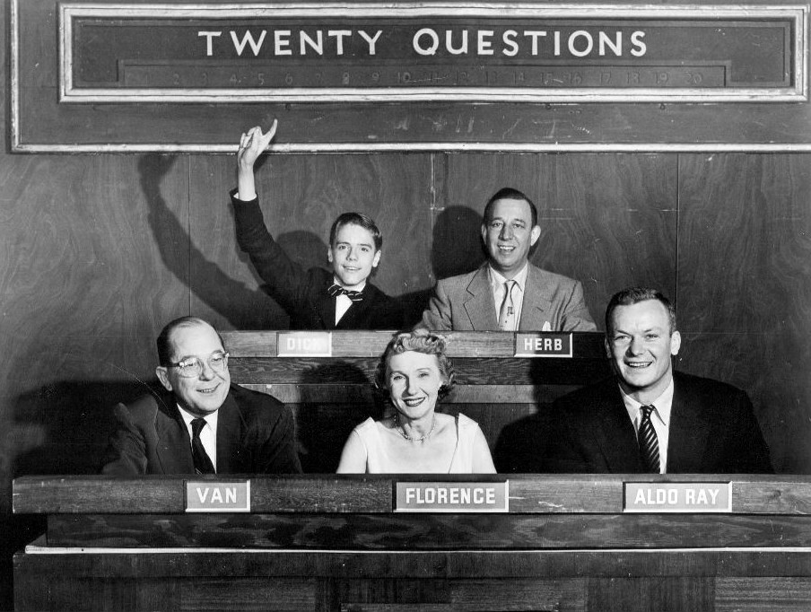
Resources
Top Issues &/or FAQs
State or county website: www. ___.gov.
Command Center/Field Captain
866-OUR-VOTE
Notes:
Slide Goal: Reassure volunteers that they will have the resources to help voters
Adaptation Note: Make #1 the printed resource your volunteers will have and use & add the state elections website for your state in #2; reorder #3 & #4 depending on your field program’s preferences
Content:
Printed resource provided with basic information about state election procedures (e.g., Top Issues to Field or FAQs)
State or county website
Command center– You’re not in this alone. Ask for help if you need it.
Hotline – hotline volunteers have access to additional resources to answer questions. If you don’t know the answer to a voter’s question, you can call the hotline and have the hotline volunteer look it up.
Photo Credit: Photo from DuMont advertising the show, with 14 year-old Dick Harrison, Herb Polesie, Fred Van Deventer, Florence Rinard, and actor Aldo Ray as guest panelist (February 1, 1954)
https://en.wikipedia.org/wiki/Twenty_Questions
Labeled for noncommercial reuse

Slide 20
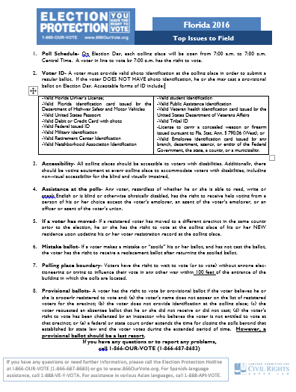
Top Questions
What time can I vote on Election Day?
What ID do I need to bring with me?
I usually translate for my mom. Can I go into the voting booth with her?
I moved a couple months ago. Am I in the right place?
Notes:
Slide Goal: Familiarize volunteers with the Top Issues one-pager and how to use this resource, as well as a few key pieces of information for a state they’ll be covering. (Note that this information can then be skipped in the Election Admin 101 Section.)
Adaptation Note: This slide is for field programs that are using the Top Issues as the go-to first resource that volunteers will bring with them in a written format to the polling place. If your field program is using the FAQs as the go-to first resource you can delete this slide or remove the questions and just mention that the Top Issues are a document they will have on hand to provide to voters. If your field program is using both, you might combine them into one slide and activity—providing both documents and listing 4 questions on the slide (with 1 or 2 that are only found in the FAQs) and giving folks 5-7 minutes of quiet time to find the answers rather than 3-4 since they will be familiarizing themselves with two differently formatted resources.
Trainer’s Notes:
Hand out a copy of this year’s Top Issues document for your state.
Discuss with volunteers when the Top Issues are the best resource to use: The Top Issues should be your first resource because they’re easy to use in the field and can even be shared with a voter if they want the information in writing for themselves. If something isn’t there, call in for help!
The activity below may seem simplistic, but giving volunteers the opportunity to get comfortable with the Top Issues document and its format during the training can go a long way toward their uptake of it when they need it, as well as the speed and efficiency with which they can answer voters’ questions.
>>Continued on next page
Content:
Re-remind the volunteers to double check anything they’re not sure of. Just because something happens a certain way at their polling place or during early voting doesn’t mean it works the same way at the polling place they’re assigned on Election Day.
Participation Opportunity:
Ask participants to spend 3 minutes on their own familiarizing themselves with the Top Issues and finding the answers to the questions listed
Give 3-4 minutes of quiet time for folks to review and look through for the answers
Bring the group back together and ask for the answers to 1 or 2 of the questions
Provide an opportunity for participants to ask questions

Slide 21
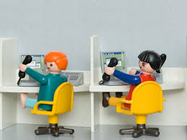
Engaging Command Center
Call your command center if there is a systemic problem, including:
  Broken machines.
  Poll workers giving wrong info.
  Intimidating flyers or police presence.
  Multiple voters reporting they are not on the rolls.
  High use of provisional ballots.
  Polls open late/close early.
  Voters who don’t speak English are having issues.
  The polling place is not physically accessible (e.g., a step w/o a ramp).
Notes:
Slide Goal: Encourage volunteers to use their command center as a resource.
Trainer’s Notes: In addition to noting the circumstances in which the command center can be helpful, also note that the rest of the field team and the national command center are backstops to help get the problem solved.
Content:
Some examples of specific issues that should involve your command center:
Machines are broken down at the polling place
Poll workers are asking for ID that is not required
Poll workers are not offering voters provisional ballots when they should be
Police presence at the polling place
If voters who do not speak English are leaving without voting
There is a step without a ramp or other issues that make the polling place difficult or impossible to access for voters with mobility challenges
Anything else that typically comes up in your state that you should be alerted to
Give an example of how command center involvement in the past has allowed for greater resolution. For example, in Pennsylvania in 2014 there was a polling place that wasn’t open in time. The command center got involved and called local election officials, who wanted to move the polling place over a mile away because no poll workers had shown up. The command center—along with voters and the poll monitor on the ground—was able to prevent this move and got the election officials to open the polling place with replacement workers by 11 a.m. rather than simply posting a sign for voters who arrived telling them to go more than a mile away, which would have been a challenge for many of the elderly voters there. The command center also worked with partners to publicize that the polling place was now open in local media.

Slide 22
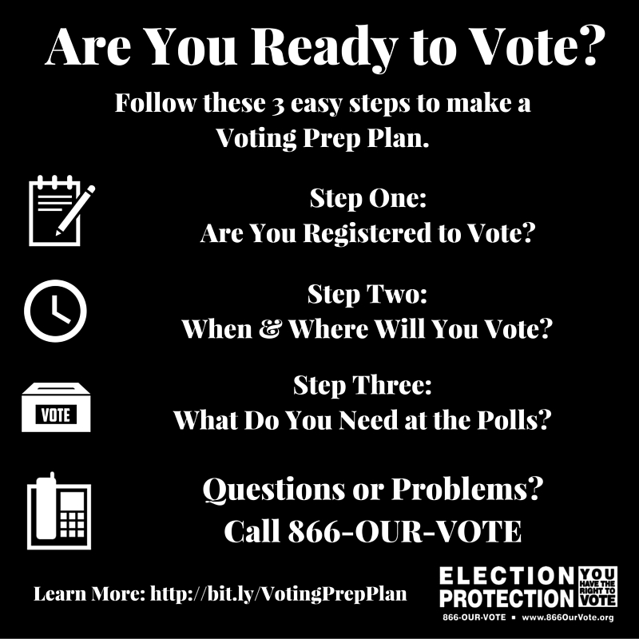
Preparing Voters Ahead of Election Day
Notes:
As we head into the final stretch we are encouraging voters to make a plan to vote which includes:
Register and verify your voter registration at your current address
Every year we have voters confused about whether they have to re-register if they have moved or the hardest call on Election Day, if they have to register at all
Voters should know when and where they will vote: if their state offers early or absentee voting or where their polling location is. We are monitoring last minute polling places.
Make sure voters know what the need to vote at the polls. Do they need ID? Do they require language assistance? Do they need a ride to the polls?
And finally make sure they know that if they have questions or problems call 866-OUR-VOTE
Photo links to online version.

Slide 23
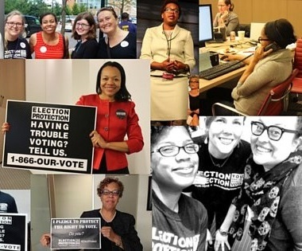
Connect with EP
  Web: http://866OurVote.org
  Facebook: www.facebook.com/866OurVote
  Twitter: @866OurVote
  Legal volunteers: http://volunteer.866ourvote.org
  Grassroots volunteers: https://protectthevote.net
Notes:
So what is unique to the election. Why do we need to support voter protection program?
The anti-immigrant and racist tone of this election has us concerned about more challenges at the polls—might be an uncoordinated effort.
Need to talk to EO’s about a safety plan, how challenges will be treated and have more poll monitories. Already working in about 24 states,
Last minute changes—Don’t have full protection of the VRA. We saw what happened in Arizona. During NC primary a polling place moved and no voters were notified. In Macon-Bibb a polling place in AA precinct moved to Sheriff’s office. Able to fight back and get moved to church but we need more resources to track these changes and stop them ahead of Eday.

Slide 24
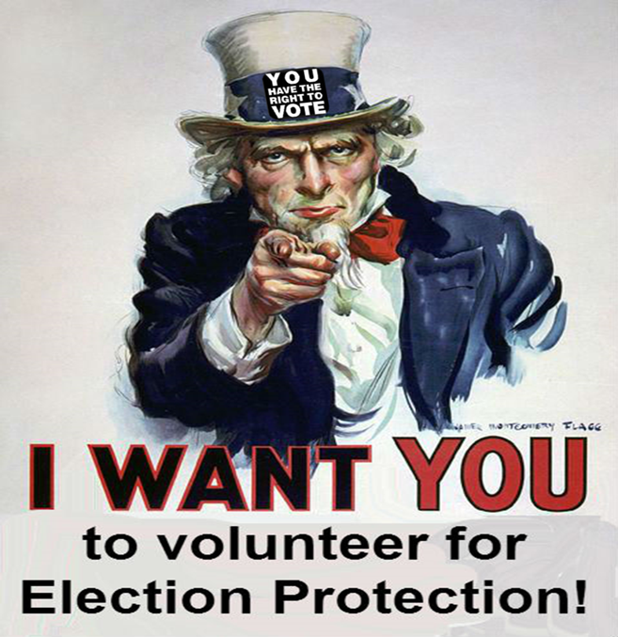
Working Together
  Volunteer
  Promote EP hotlines
  Share information with network
  Vote
Notes:
So what is unique to the election. Why do we need to support voter protection program?
The anti-immigrant and racist tone of this election has us concerned about more challenges at the polls—might be an uncoordinated effort.
Need to talk to EO’s about a safety plan, how challenges will be treated and have more poll monitories. Already working in about 24 states,
Last minute changes—Don’t have full protection of the VRA. We saw what happened in Arizona. During NC primary a polling place moved and no voters were notified. In Macon-Bibb a polling place in AA precinct moved to Sheriff’s office. Able to fight back and get moved to church but we need more resources to track these changes and stop them ahead of Eday.

